Slide 1
CSC525 PROJECT Centipede bomber
By: David Wine and Joshua Stark

Slide 2
Motivations
We both liked old school 80’s games and wanted to reproduce one with a slightly new twist
Produce a demo of the game complete with nag screens to buy the game when it is released
Make a fun and interactive game that feels like an actual demo
Primary change we wanted to original Centipede game was introduction of the bomb
The bomb adds a new element to the game that helps to create a new and interesting feel to a classic game

Slide 3
Gameplay
Ship moves around with mouse in a bounded area on bottom
Ship able to shoot and blow up bombs on left mouse click
Bombs when blown up can destroy surrounding mushrooms, a centipede segment if centipede near, and destroy ship if it blows up to close to it
Bombs can hit mushrooms and centipede, and can be blown up when in midair or after hitting something
Centipede moves towards bottom in an attempt to hit and destroy ship, bouncing off walls and mushrooms along the way
Mushrooms continually change colors for added visual affect
Four levels total, each with more mushrooms, and the centipede becoming more ghostlike by losing line density, until all you can see are his eyes

Slide 4
WINDOWS
Splash Screen
Same splash screen as from our homework 3
Gives a visual teaser for our game before gameplay
Game Window
Interactive window where game is played
Nag Screen
Displays 3D stroke text which reminds the user that the game is a demo
Text rotates around Y axis for added effect
Instructions Screen
Displays instructions for playing the game
When user clicks left button game starts

Slide 5
Windows continued
Pause Screen
If player presses spacebar, pause screen displayed
Simple message showing game paused
Left click to continue game
Level Up Screen
Tells user they finished level
Left click to continue to next level
Win Screen
Congratulates user on beating game
Multiple Levels
Four levels total of increasing difficulty

Slide 6
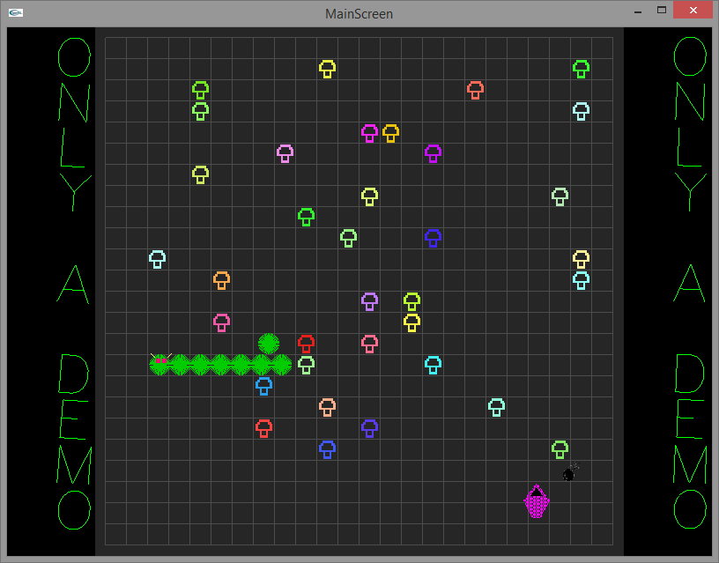
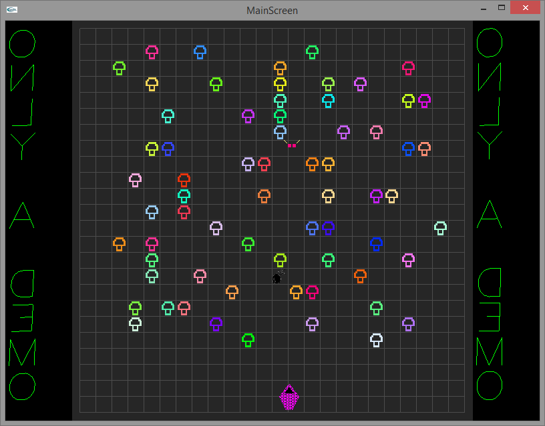
GAMEPLAY WINDOWS

Slide 7
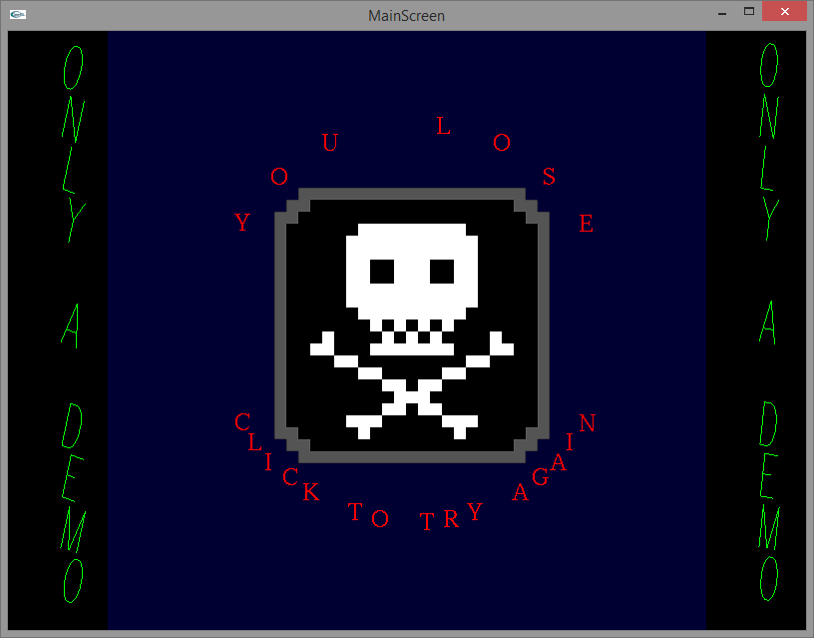
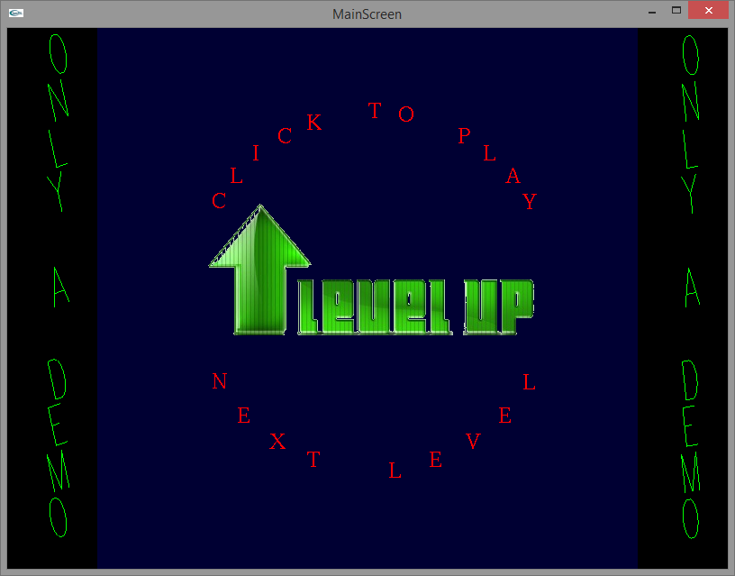
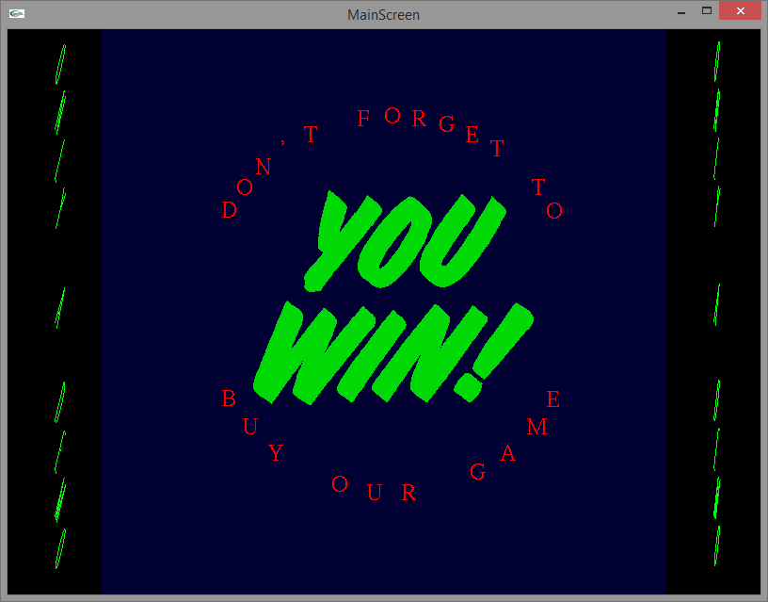
WIN AND LOSS SCREENS

Slide 8
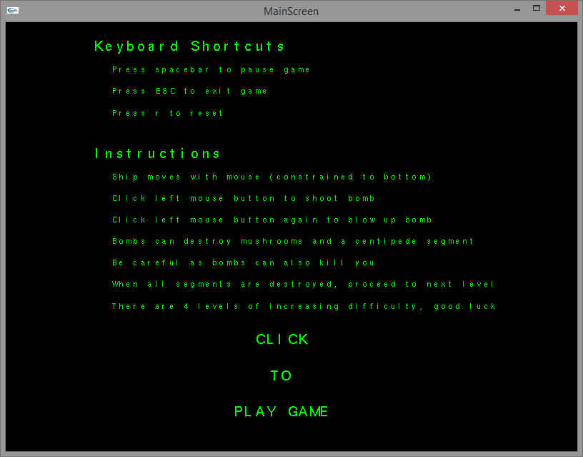
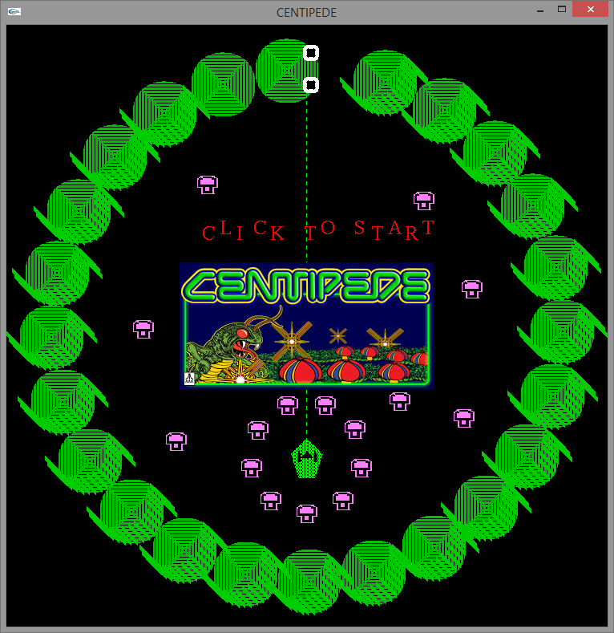
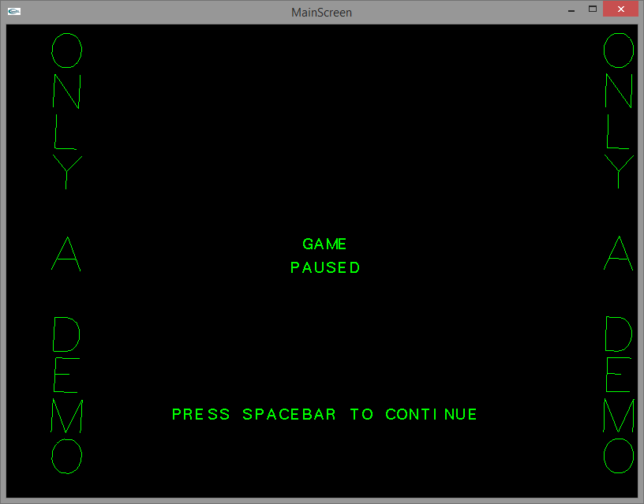
OTHER SCREENS

Slide 9








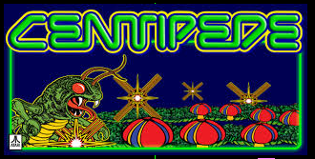

Resources
We used various resources to make the game visually appealing
We created each mushroom as a bitmap
Ship was a polygon that used a polygon stipple
Centipede was made out of a dense collection of lines in a circular pattern
Skull and crossbones, bomb, explosion, you win text, level up image, and centipede image on splash screen were all images converted into binary files as a pixel map
Most of the images were also converted in a way so that edges were transparent and looked neat in the program

Slide 10
CLASSES
Grid
Bomb
Centipede
Centipede Segments
Ship
Mushrooms
Mushroom fields
Most classes had to implement basic interactions with each other in some form, as well as methods to display that class on the screen

Slide 11
EVENT Driven Programming
Many elements of our program required specific mouse and keyboard events to make the program smooth and user friendly
Some examples include:
Passive mouse movement for ship
Shooting and exploding bombs through mouse click
Keyboard events to reset, pause, play, and exit game

Slide 12
3D Additions
The original goal of our game was simply a basic 2D arcade like game
In order to include a 3D element to the game, and make it more visually appealing, we included 3D stroke text on side panels
We added stroke text that rotates around in a viewport in each panel
The text displays a message reinforcing that the game is just a demo
We purposefully made the text somewhat simple so as not to distract the user from the actual game

Slide 13
Code structure
We tried our best to ensure logical separations of the code were also represented as structurally separate.
We had a main file that primarily interacts with the other files
We also had a file primarily focused on event driven programming
One other file had most of the classes and other content associated with actual underlying gameplay interactions
Other files included were a variables file, a file for the splash screen and initial setup, and several header files that allowed the files to work in conjunction

Slide 14
IMPLEMENTATION
Gameplay:
Collision detection for all the various objects on the screen
Drawing the various objects (including translations to simulate movement)
Various events and Boolean values handling all the interactions
Bombs and explosions used pixel maps, mushrooms were a bitmap
Menus and Screens
Each menu had certain event interactions
The side panels used 3D translations and rotations to display text
Most screens had some kind of pixel map in them

